Slide 1
NSQ1, Session 1
Introduction

Slide 2
About me
Ole Ildsgaard Hougaard
oih@via.dk
Computer Scientist (PhD)
Programming languages
Type systems
Industry experience
Uni-C
Educational Software, Games
Senior Developer
Acure / IBM
Healthcare solutions
Developer, architect, Scrum master
Google
V8 JavaScript Engine
VIA since 2009

Slide 3
About the course
SQL vs NOSQL
Comparison
Making the same exercise 3 times
3 Course assignments
Oral exam

Slide 4
Topics
MongoDB
Data model
Querying incl. aggregation pipeline
Updating
Schemaless vs Schema
Cloud and graphQL
neo4j
Data model
Cypher language (updating and querying)
graphQL
Graph algorithms

Slide 5
“versus”
Comparison
What’s the same?
What’s different?
3 course assignments:
Amazon case in SQL
Amazon case in MongoDB (compare)
Amazon case in neo4j (compare)

Slide 6
Exam
20 minutes oral
2 parts:
Theoretical
Part of the course assignment
Breadth over depth

Slide 7
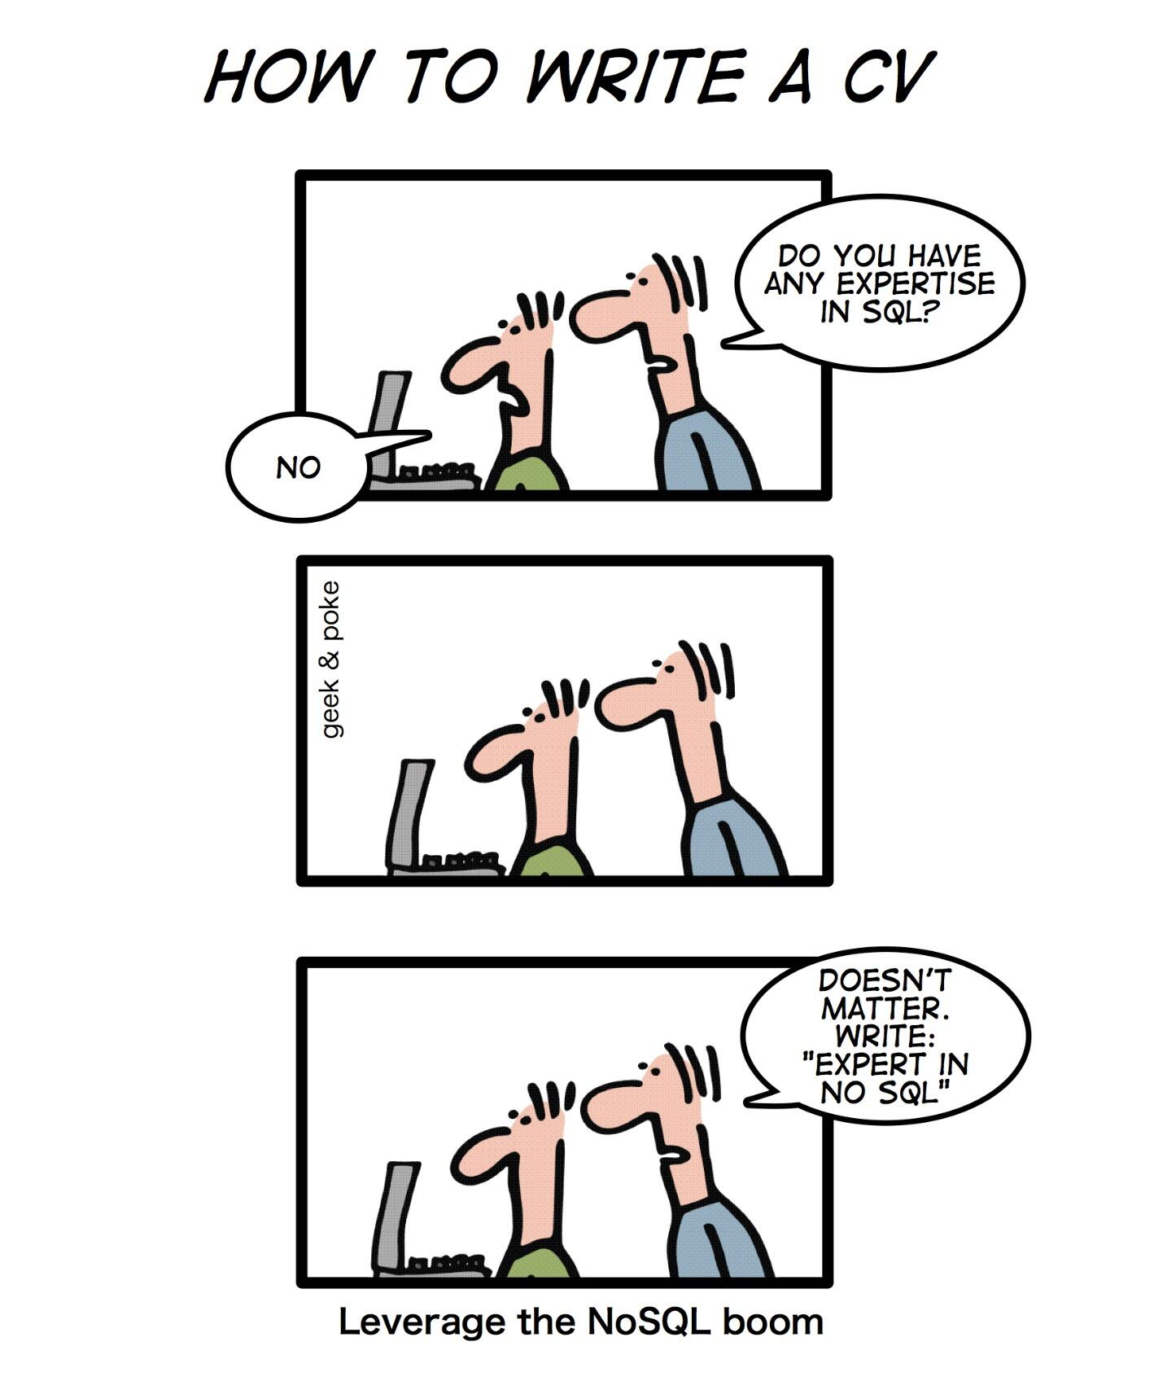
noSQL
Coined by Johan Oskarsson in 2009 (San Francisco NOSQL meetup)
Hard to define (what’s “non-classical music”?)
Key features (to varying degrees):
Focus on scalability
Support for data intelligence
Non-relational
Schemaless

Slide 8
Non-relational
If not relational, then what?
Object databases (not popular)
Key/value pairs (Great for data intelligence)
Tuple databases
Document databases
Graph databases

Slide 9
Schemaless
What is a schema?
Namespace: CREATE SCHEMA Amazon;
Is the set of CREATE TABLE statements: Types and Constraints used to create your database – Ruleset.
Schemaless: There are no rules.
There is still a data format.
Schema optional: As much schema as you need.

Slide 10
Design strategy
Relational (SQL)
NOSQL (e.g. MongoDB)
Entities + relationships – conceptual (E)ER model
Normalize
Map to the logical model (GRD)
CREATE TABLE statements
INSERT data
Entities + relationships – conceptual (E)ER model
DO NOT NORMALIZE
Map to JSON collections
Optional: Create schema
Insert data

Slide 11
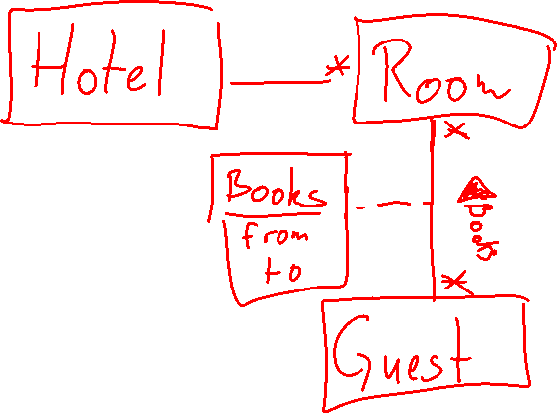
Conceptual Model
Technology independent
Entities + Relationships
Not "tables"
Includes *-to-* - relationships
May have specializations
Natural primary keys
No
Join tables
Artificial primary keys
Foreign keys

Slide 12
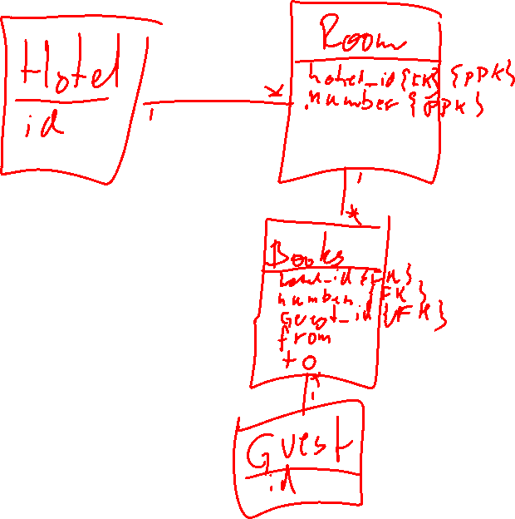
Logical Model
Relational
Mapped from the conceptual model
No *-to-* relationships
Join tables
All tables has primary keys - possibly artificial
Foreign keys
Used to create the tables

Slide 13
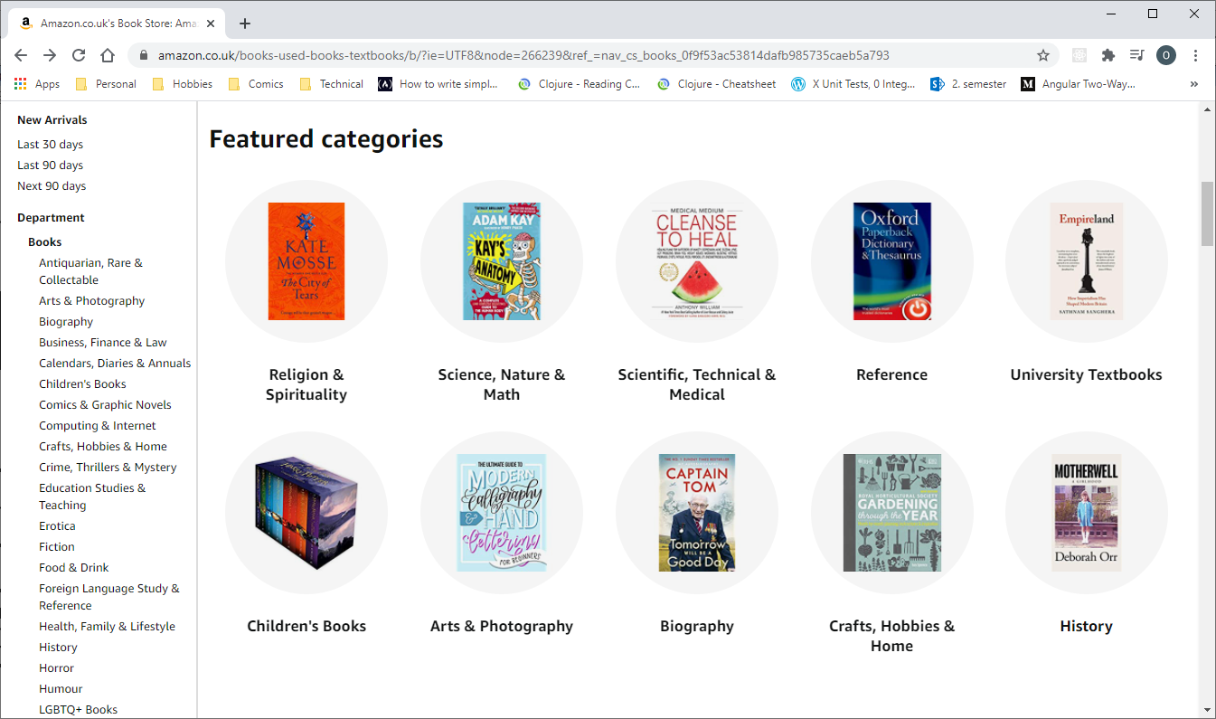
Baseline
Course assignment 1

Slide 14
Hints for the Course Assignment
The modifications are meant to test your database design. Use them to iterate over your design.
In particular, your database should be ready to handle modification 5
Don't assume that you know how deep the category hierarchy goes - design for flexibility
This also includes queries 12 - 14. Look for books in sub-categories, sub-sub-categories and so on, …
When querying, it's sometimes easier to find what you don't need and remove it

Slide 15
Course assignments
Based on the real Amazon (UK) book section
Only part of the book section need to be modelled
This is a real website that has evolved organically over many years
It's a bit weird
I can't answer all your questions
Look around and see what you can find.

